Slide 1

LENNARD HIGH SCHOOL
Athletic Paperwork
Directions

Slide 2
List of Documents Needed For Athletic Clearance
EL2 (Physical) on approved HCPS EL2 DATE 4/24
Birth Certificate
Proofs of Residence (TECO/water bill within 30 days of athletic clearance application, If using lease student MUST be listed as an occupant)
3 FHSAA Required Videos
Government Issued ID of parent signing forms
School Health of Florida Insurance ID card (hcpsathleticprotection.com)

Slide 3
Documents required #1 physical
Prior to starting, you will need the following documents
FHSAA EL2 Physical - use EL2 on SDHC Athletics website -https://www.sdhc.k12.fl.us/doc/list/athletics/student-forms/39-285/
  MUST be on this form. Physicals are good for 365 days
  Please answer all questions. Any yes answers MUST be explained at the bottom of page 4.
  Student and Parent MUST sign the bottom of page 4.
  MUST include doctor’s stamp, signature, printed name and date on page 4.
  Make sure the ELIGIBLE FOR ALL SPORTS WITHOUT RESTRICTION box has been checked by your physician.
    If not cleared without restriction – you WILL NEED page 5 of the EL2. This is the clearance and will need to be marked cleared without restriction after the visit to the referred doctor/specialist
    Upload each page separately under EL2. Page 4 is only necessary if page 5 is marked with recommendations.

Slide 4
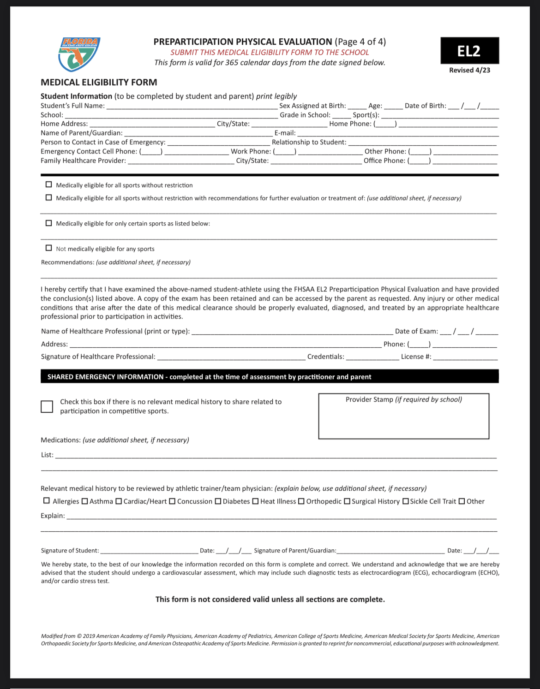
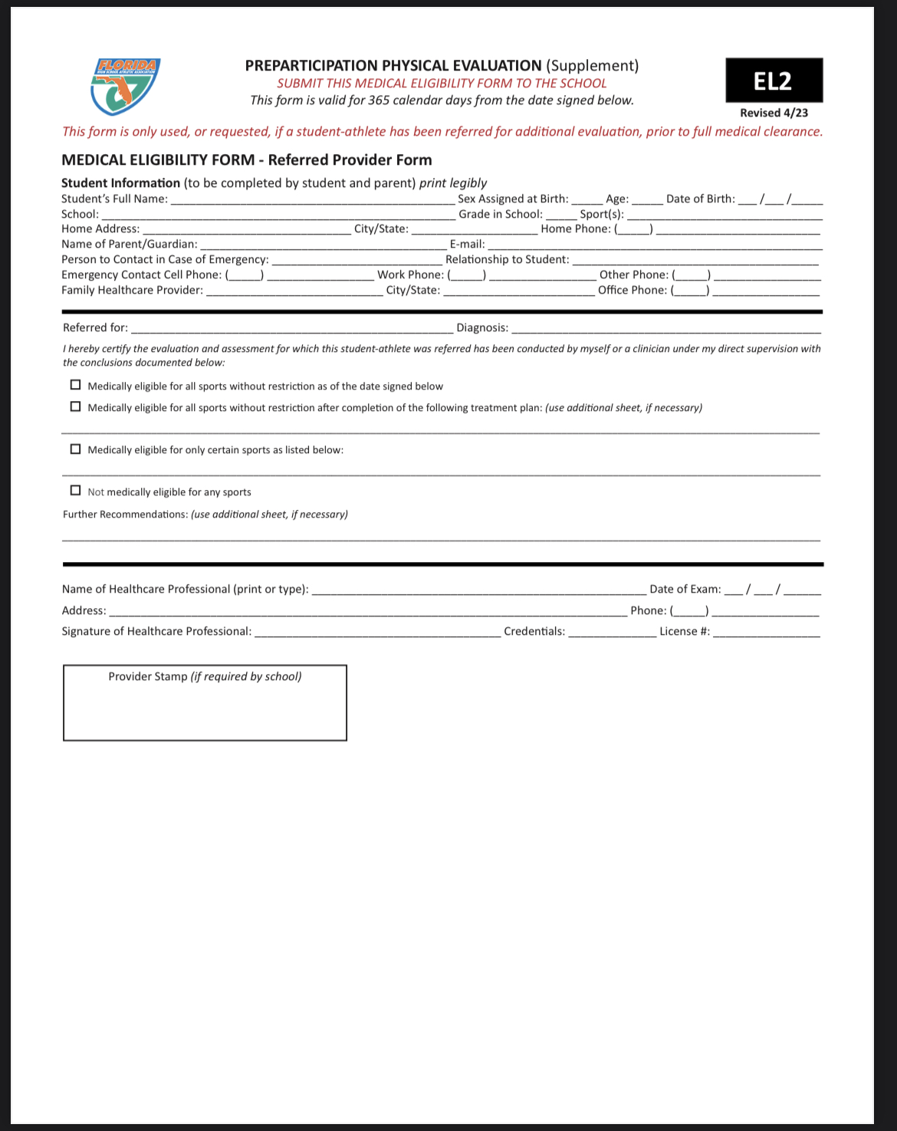
Student’s Information MUST be completed at the TOP!
Doctor’s Name MUST be Printed
Doctor’s Signature & Date
Doctors Office Address and Phone # (Or Stamp)
Only Necessary if Recommendations were made on page 5 and form MUST be completed by specialist listed on recommendation/precaution etc.…
MUST be signed and completed!
ANSWER ALL QUESTIONS!
COMPLETE PERSONAL INFO
Don’t forget shot information!
Yes, answers MUST be explained at the bottom.

Slide 5
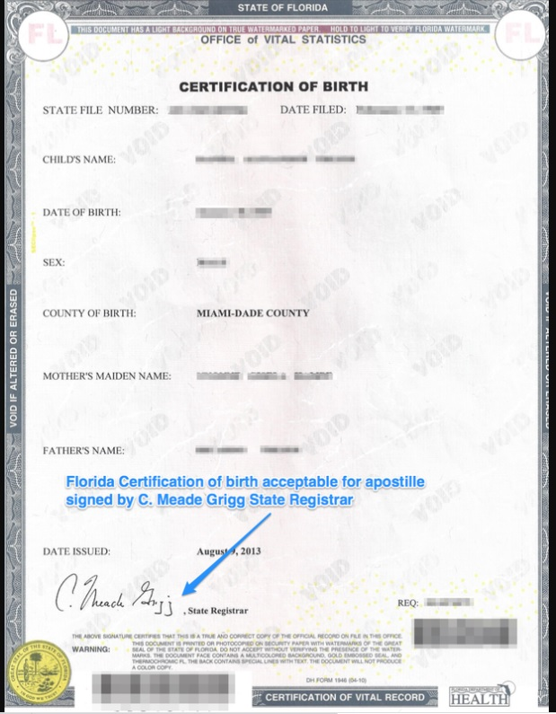
Documents required #2 certified copy of student athlete’s birth certificate

Slide 6
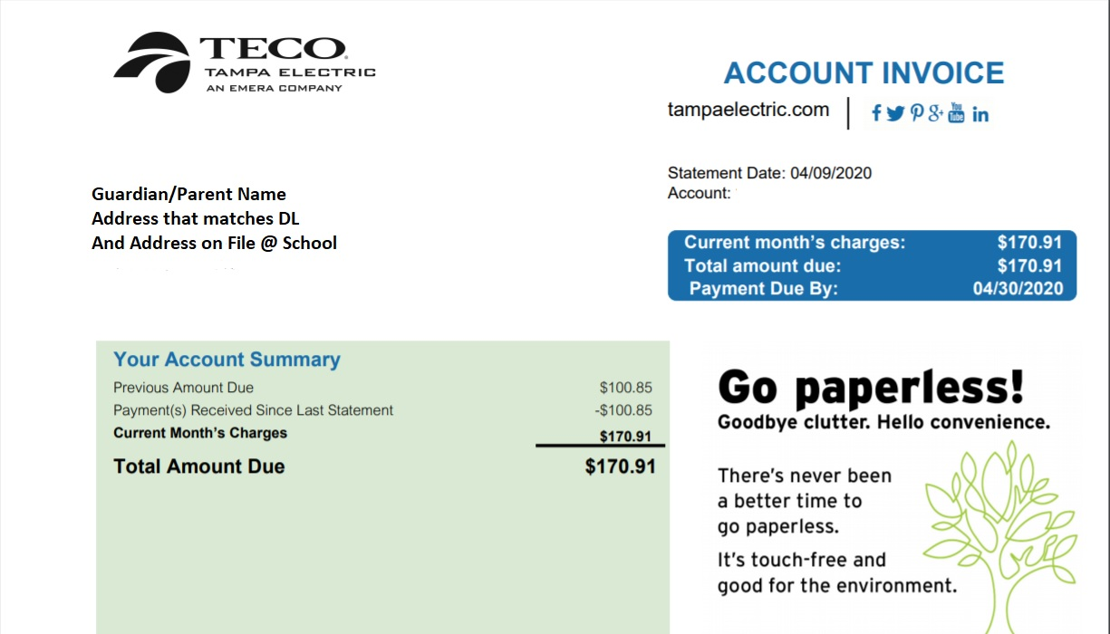
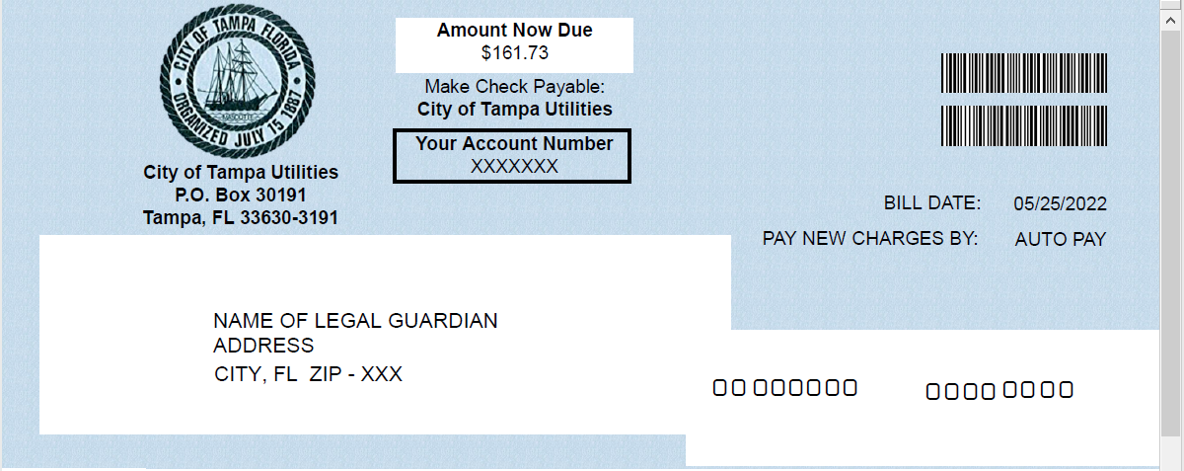
Documents required #3 (2) proofs of residence
MUST be “living proof”
MUST be within 30 days of application
Address MUST match address on government issued ID and address on file at school
Examples: (Acceptable proofs of residence):
  TECO Bill
  Water Bill
  Lease (with occupants listed)
  Mortgage Statement
Not Accepted:
  Cable Bill
  Phone Bill
  CC Bill

Slide 7
Documents required #4: FHSAA Video certificates
Viewing the videos is required each year. For the 2024-25 school year, videos must be viewed AFTER May 15, 2024.
www.nfhslearn.com
Have the student log in or create an account. Be sure when asked for the name on the certificate the STUDENT’S NAME is entered and NOT the parent. The student is responsible for watching the videos, not the parent.
Order the following courses (they are FREE). Once you have completed checkout, the student can access the courses in their Dashboard.
  Concussion in Students – What You Need to Know
  Heat Illness Prevention
  Sudden Cardiac Arrest
  Once the student has completed all three courses, download the certificates.
  Use the upload tips for multiple pages to upload the certificates.

Slide 8
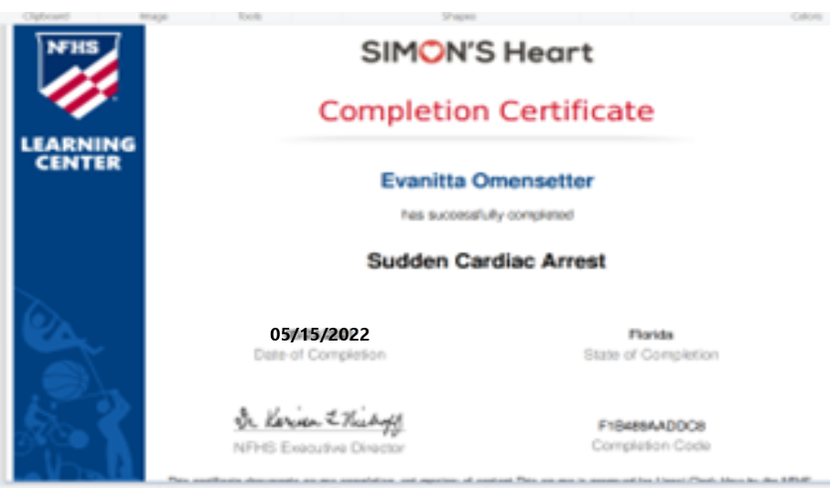
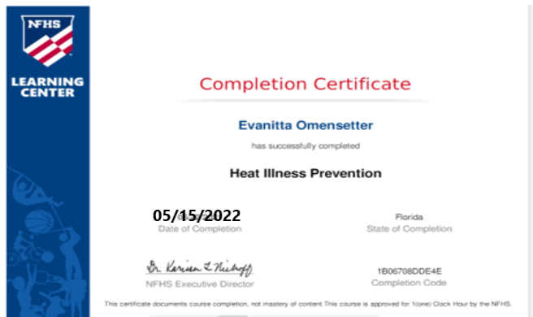
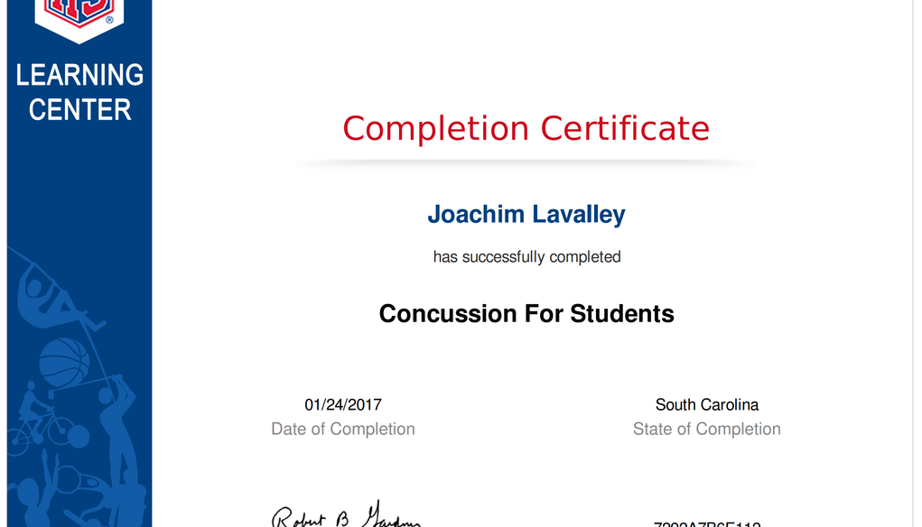
Documents required #2 FHSAA VIDEO Certificates
Certificates for the three required FHSAA videos (in student’s name) from nfhslearn.com.
Upload each certificate in the appropriate places in the files section.
Videos must be completed after May 15, 2024, of the current year to be accepted for the 2024-2025 school year
5/15/2024

Slide 9
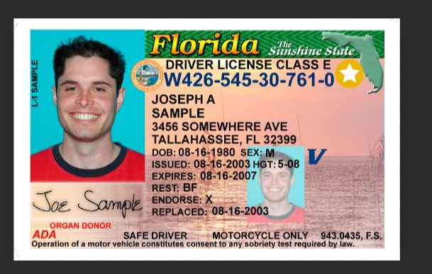
Documents required #5 Government issued ID
Government issued photo identification of parent or legal guardian signing the forms.
Address MUST match address on file and proof of residence for athletic clearance
When scanning this document, make sure all information is clearly visible in the picture.

Slide 10
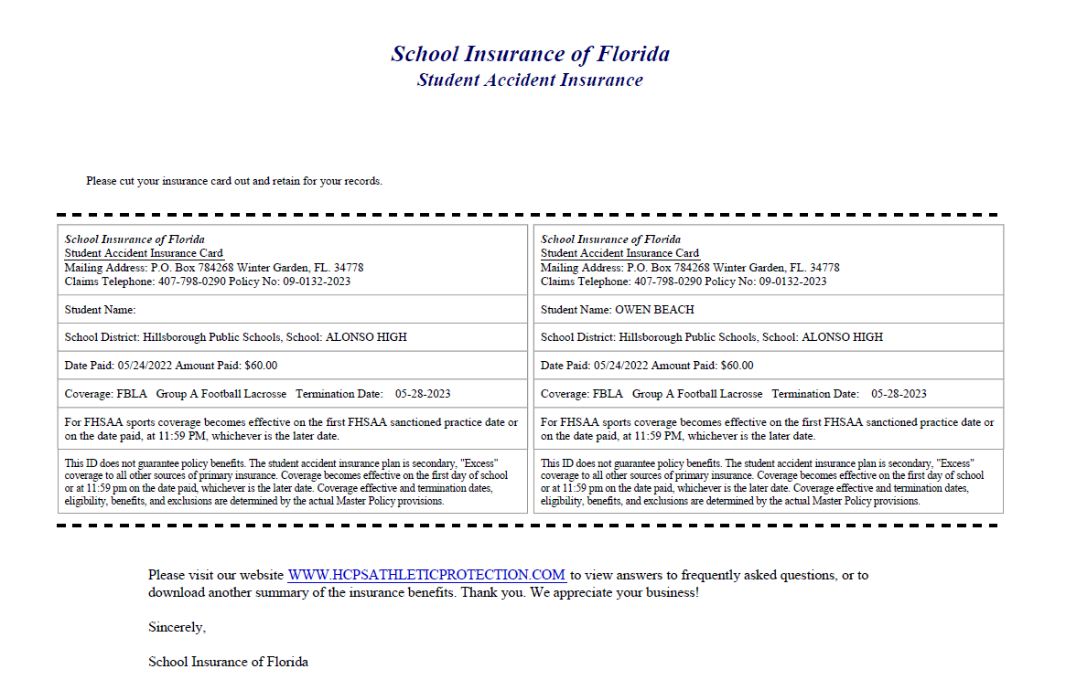
Document # 6: Insurance id card
Log into your school insurance of Florida account (https://hcpsathleticprotection.com/)
Download/print and/or Save your insurance ID card provided after purchase.
Upload to your athletic clearance account

Slide 11

DOCUMENT CHECKLIST:
Before logging in or creating an account on athletic clearance make sure you have all the following
List of Documents Needed For Athletic Clearance
EL2 (Physical) on approved HCPS EL2 Date 4/24
Birth Certificate
Proof of Residence (TECO/water bill within 30 days of athletic clearance application)
3 FHSAA Required Videos
Government Issued ID of parent signing forms
School Health of Florida Insurance ID card (hcps athletic protection)

Slide 12
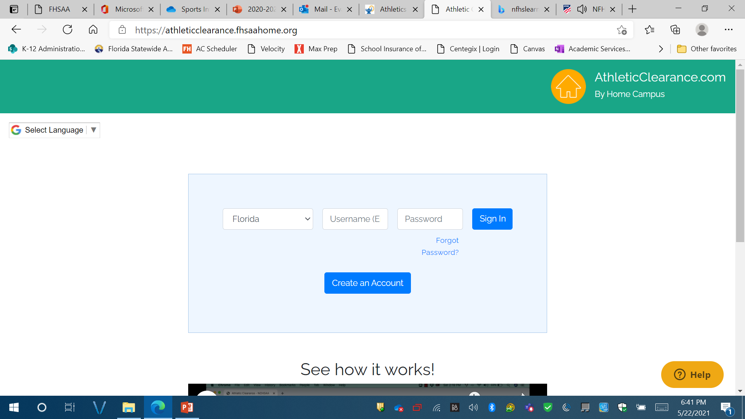
Logging In
https://athleticclearance.fhsaahome.org/
If you have ever had an account, log in here. If you have forgotten your info, DO NOT create a new account. Use the reset or HELP options.
If you have never logged in – click here to create an account.
The parent must create the account using THEIR email, not the student’s.

Slide 13
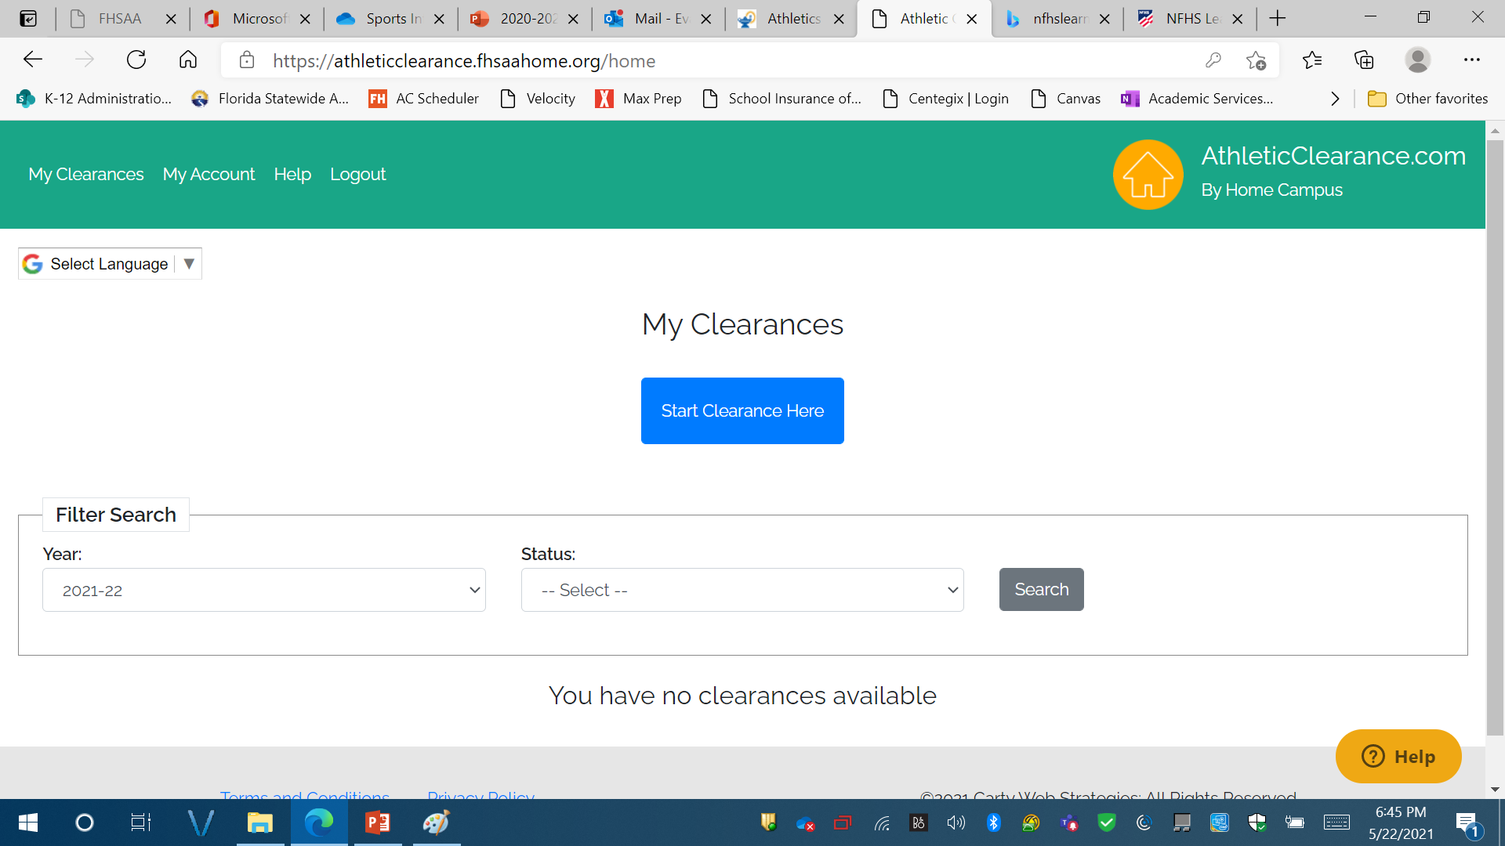
After Logging In
Click “Start Clearance Here”

Slide 14
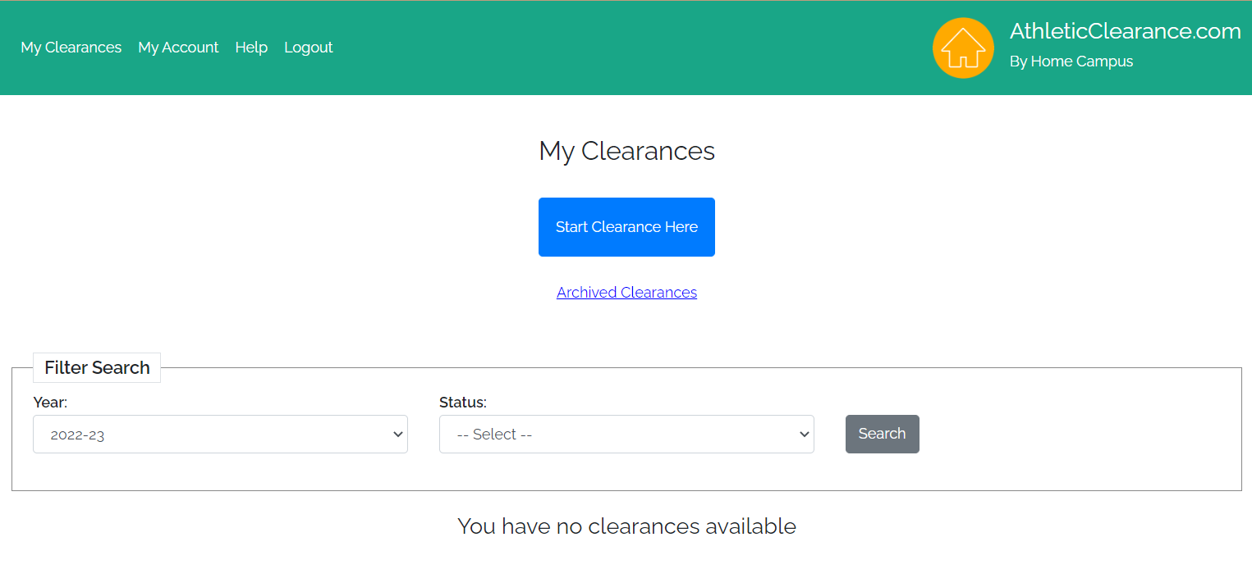
Select school Year
Choose 2024-25

Slide 15
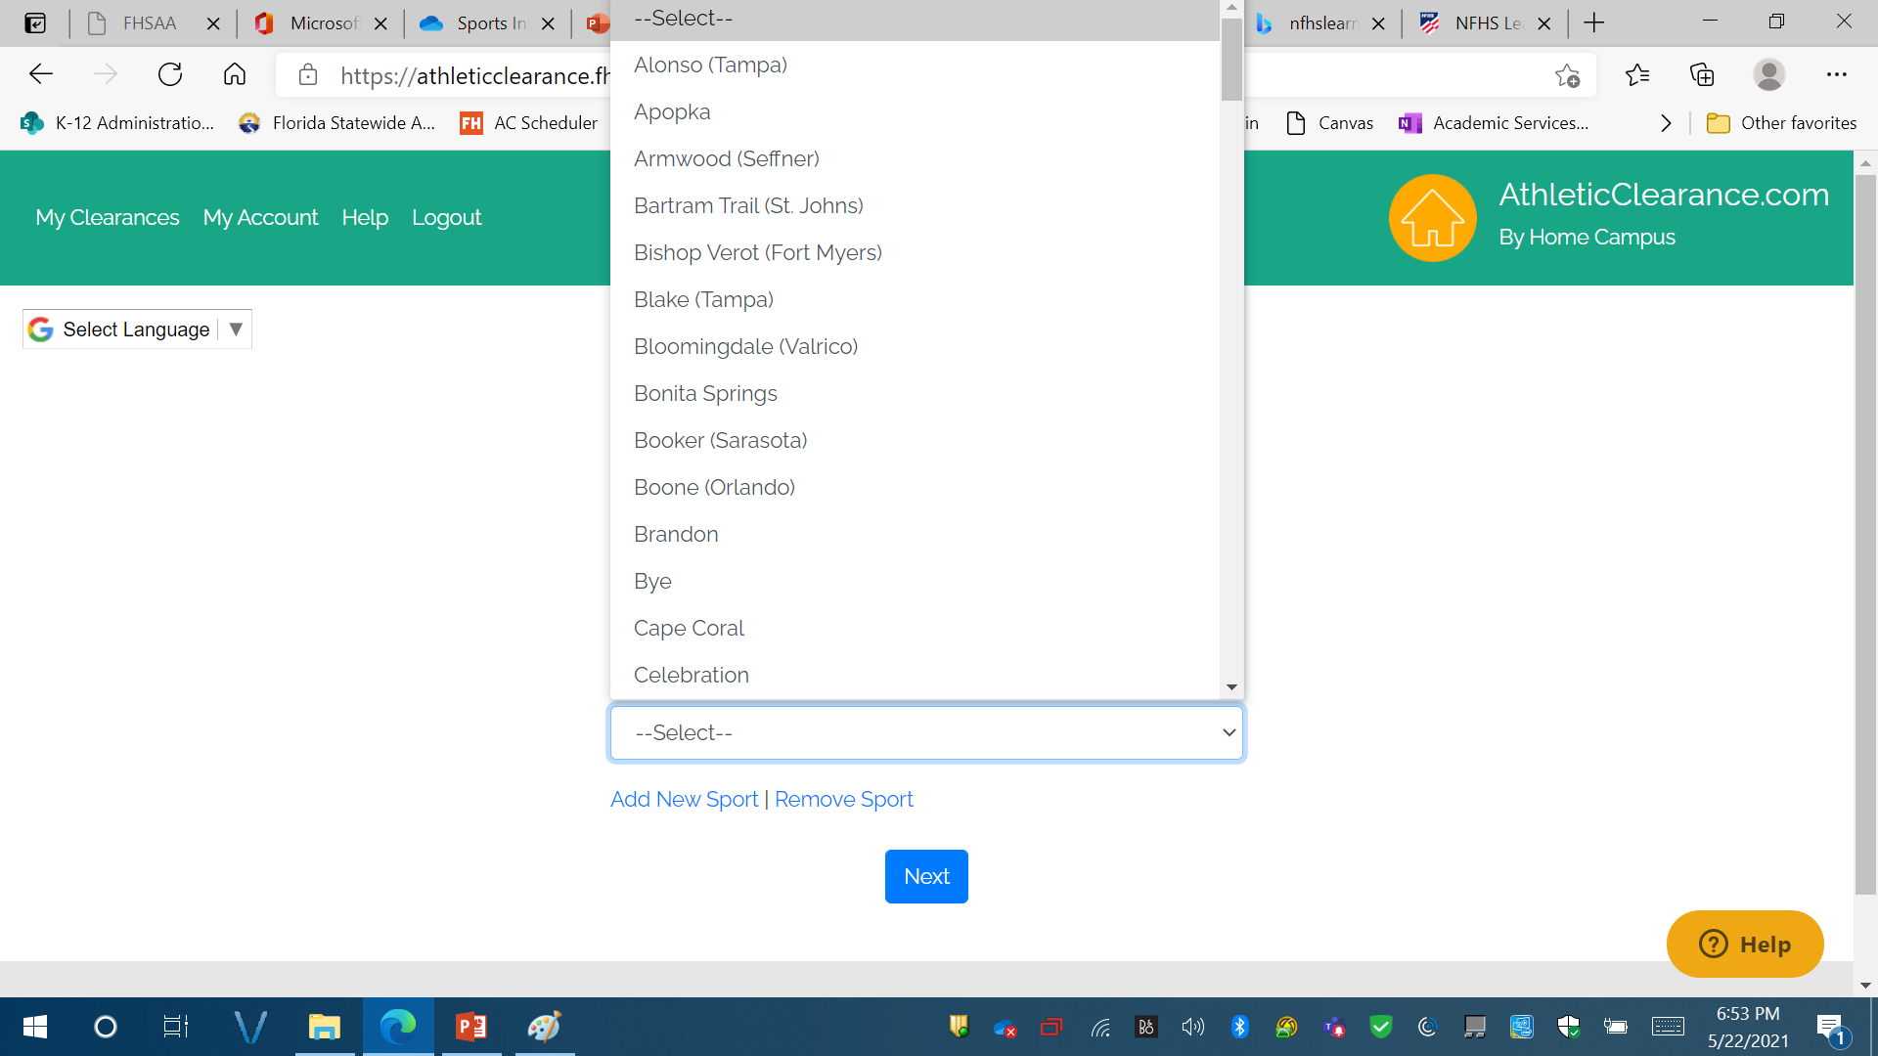
Select school
Scroll and Choose Lennard High School

Slide 16
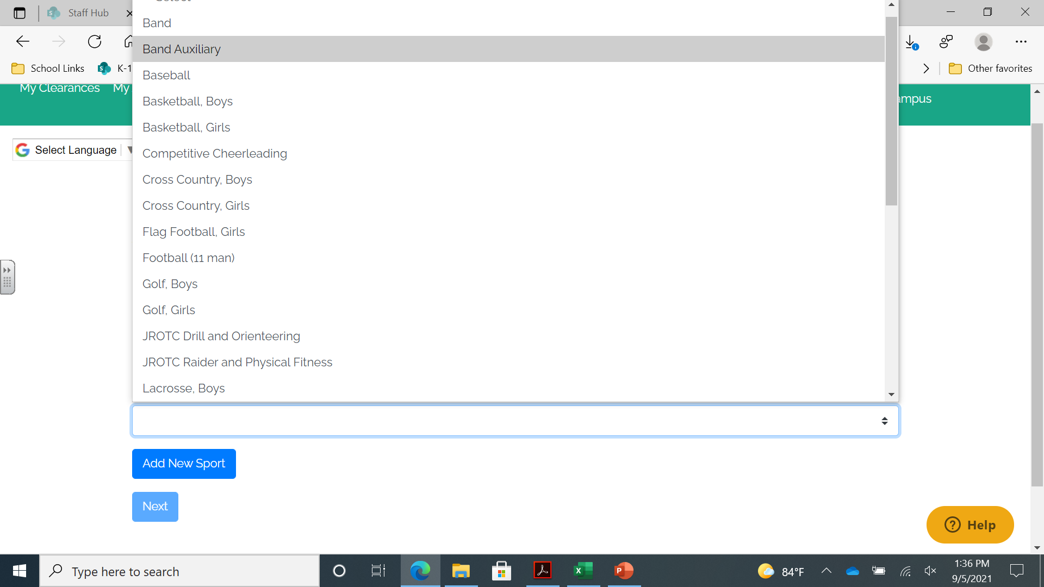
Select Sport
Choose Sport

Slide 17
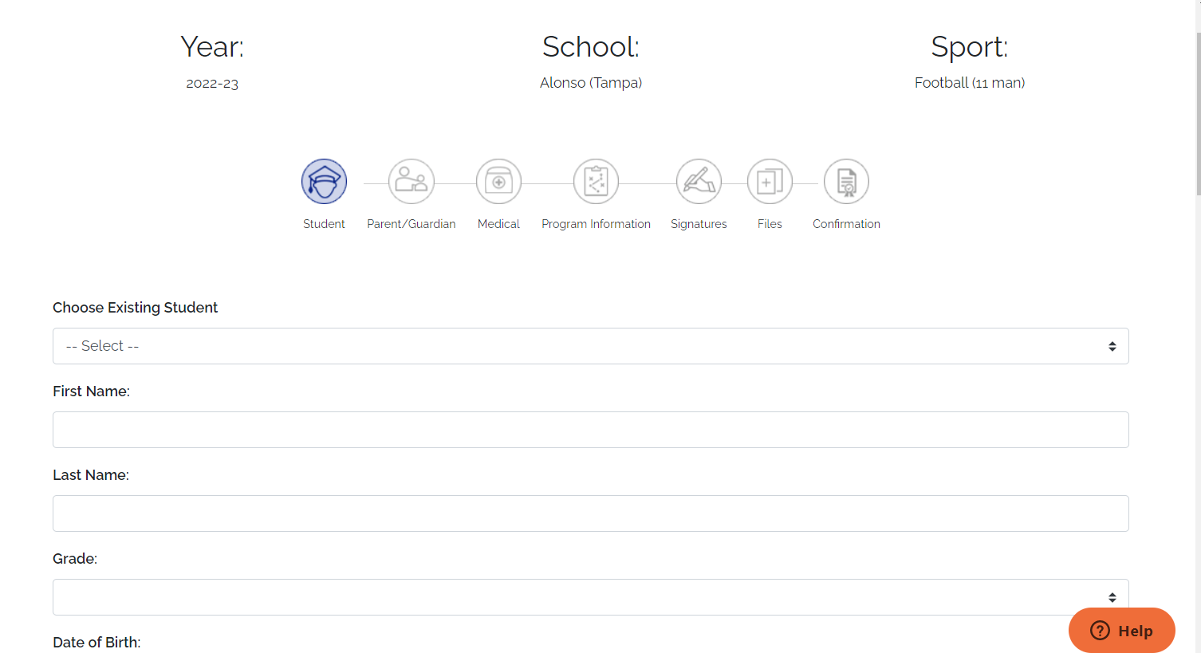
If you are an existing student select your name from the drop down.
Note: This is a form of communication, the more accurate it is the better we can communicate.
If you are a new student start entering your information, click save and continue

Slide 18
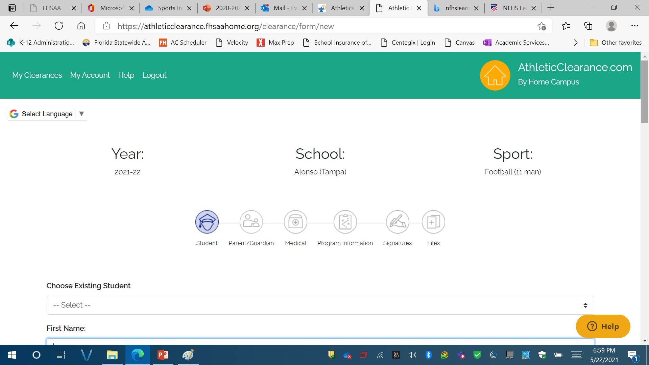
Student Information
This page is for information about your STUDENT.
Complete the form and click on save and continue
Accurate information is needed here

Slide 19
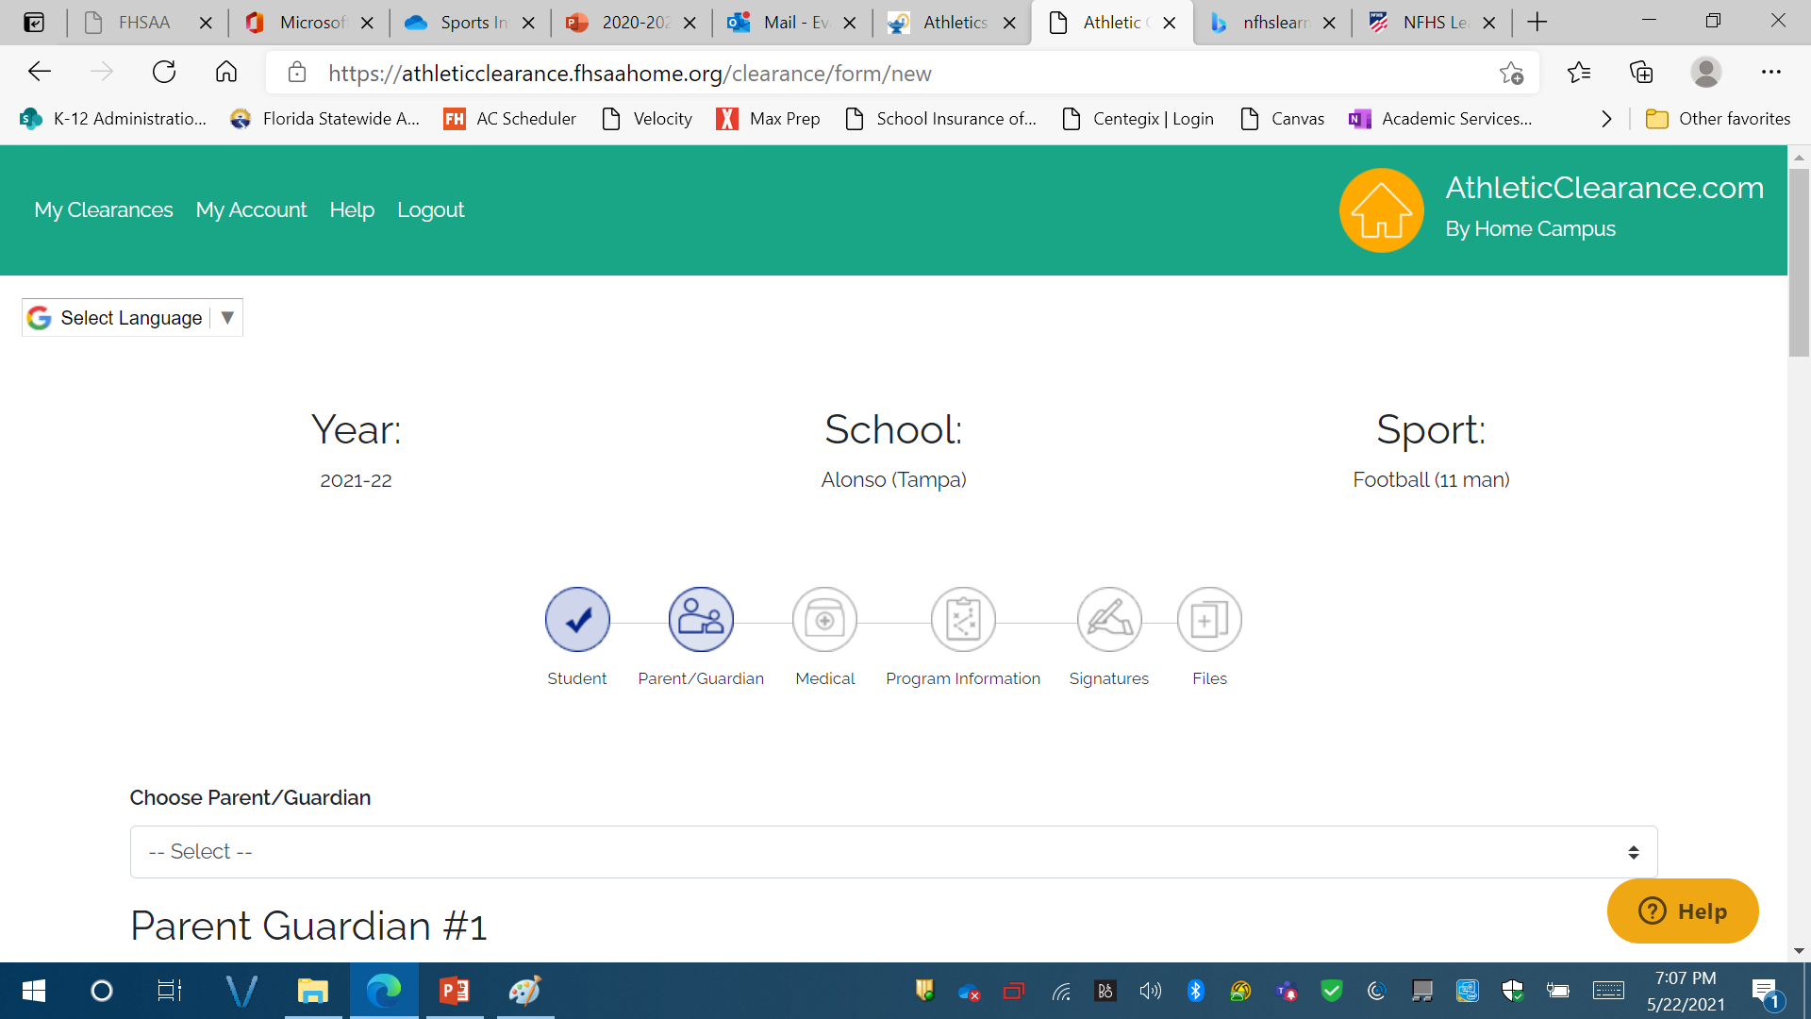
Parent guardian information – this serves as our emergency card – please be accurate
Complete Parent/Guardian Information. This SERVES AS YOUR STUDENTS EMERGENCY CARD – please complete this section with accurate information
Click on save and continue

Slide 20
Parent guardian information – this serves as our emergency card – please be accurate
Complete Parent/Guardian Information.
If you are returning student – you should be able to select your parents name from the drop down menu.
This serves as your student’s emergency card – please complete this section with accurate information
Click on save and continue

Slide 21
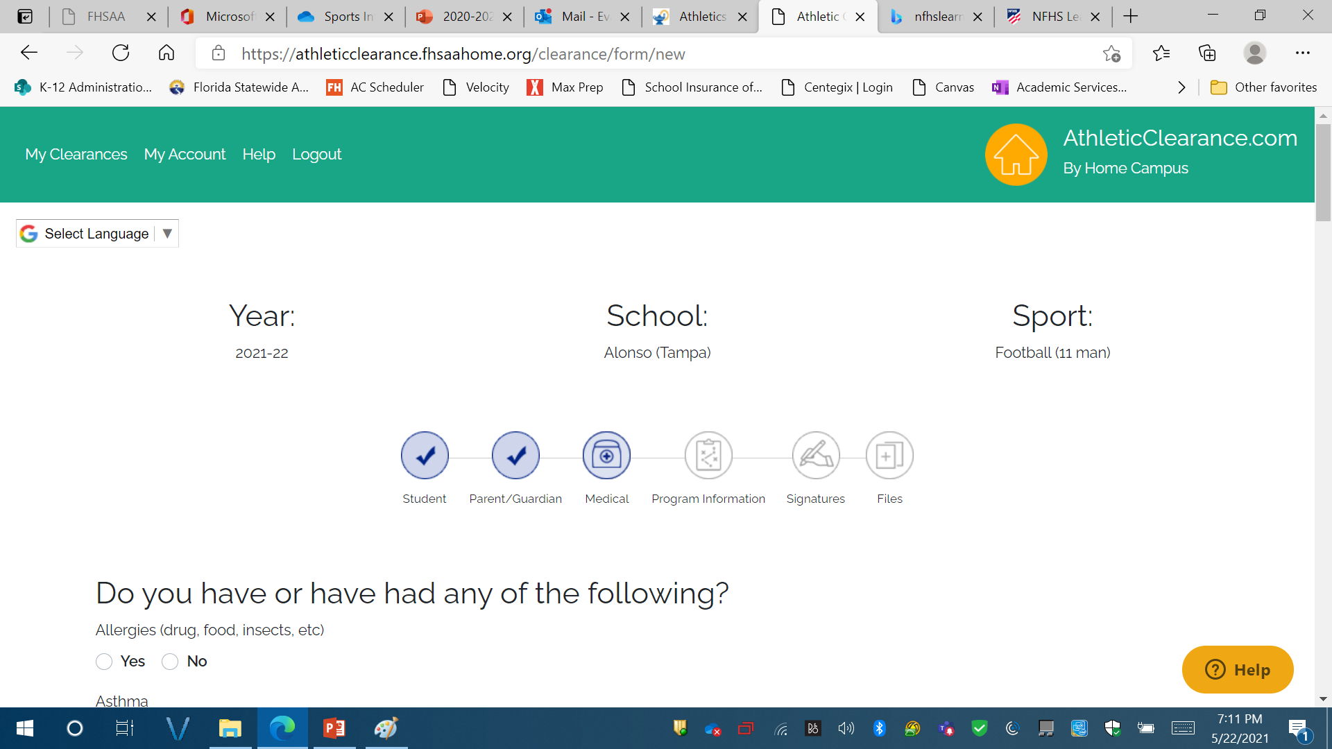
Student medical history information
This is your student's medical history information.
Please complete as accurately as possible.
Click on save and continue

Slide 22
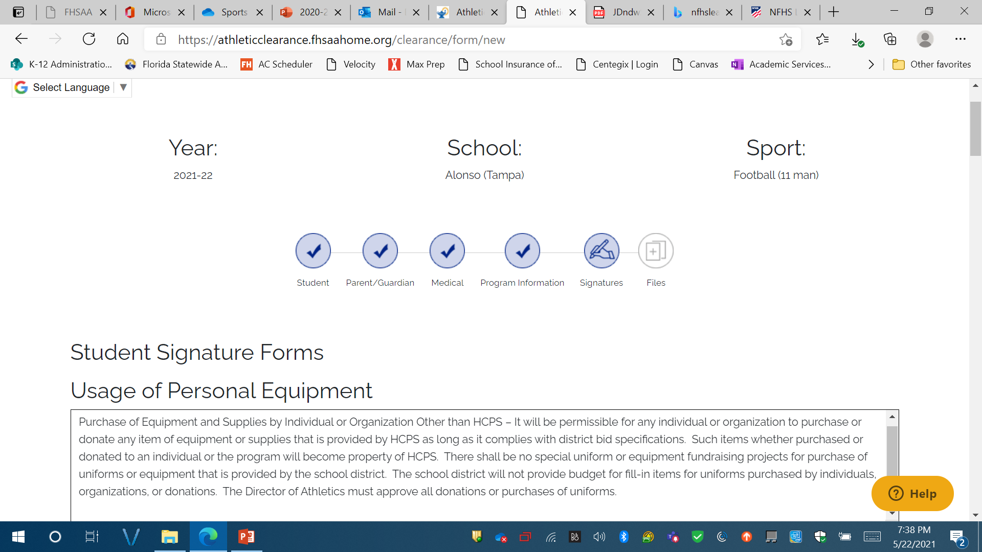
Student signature forms:
Must sign full name
Note:
IF STUDENT HAS THE SAME NAME AS PARENT SIGNING THE FORMS, DIFFERENTIANTION MUST BE MADE.
FOR EXAMPLE:
John doe, AND John doe JR.
OR
John c doe, AND JOhn S. doe

Slide 23
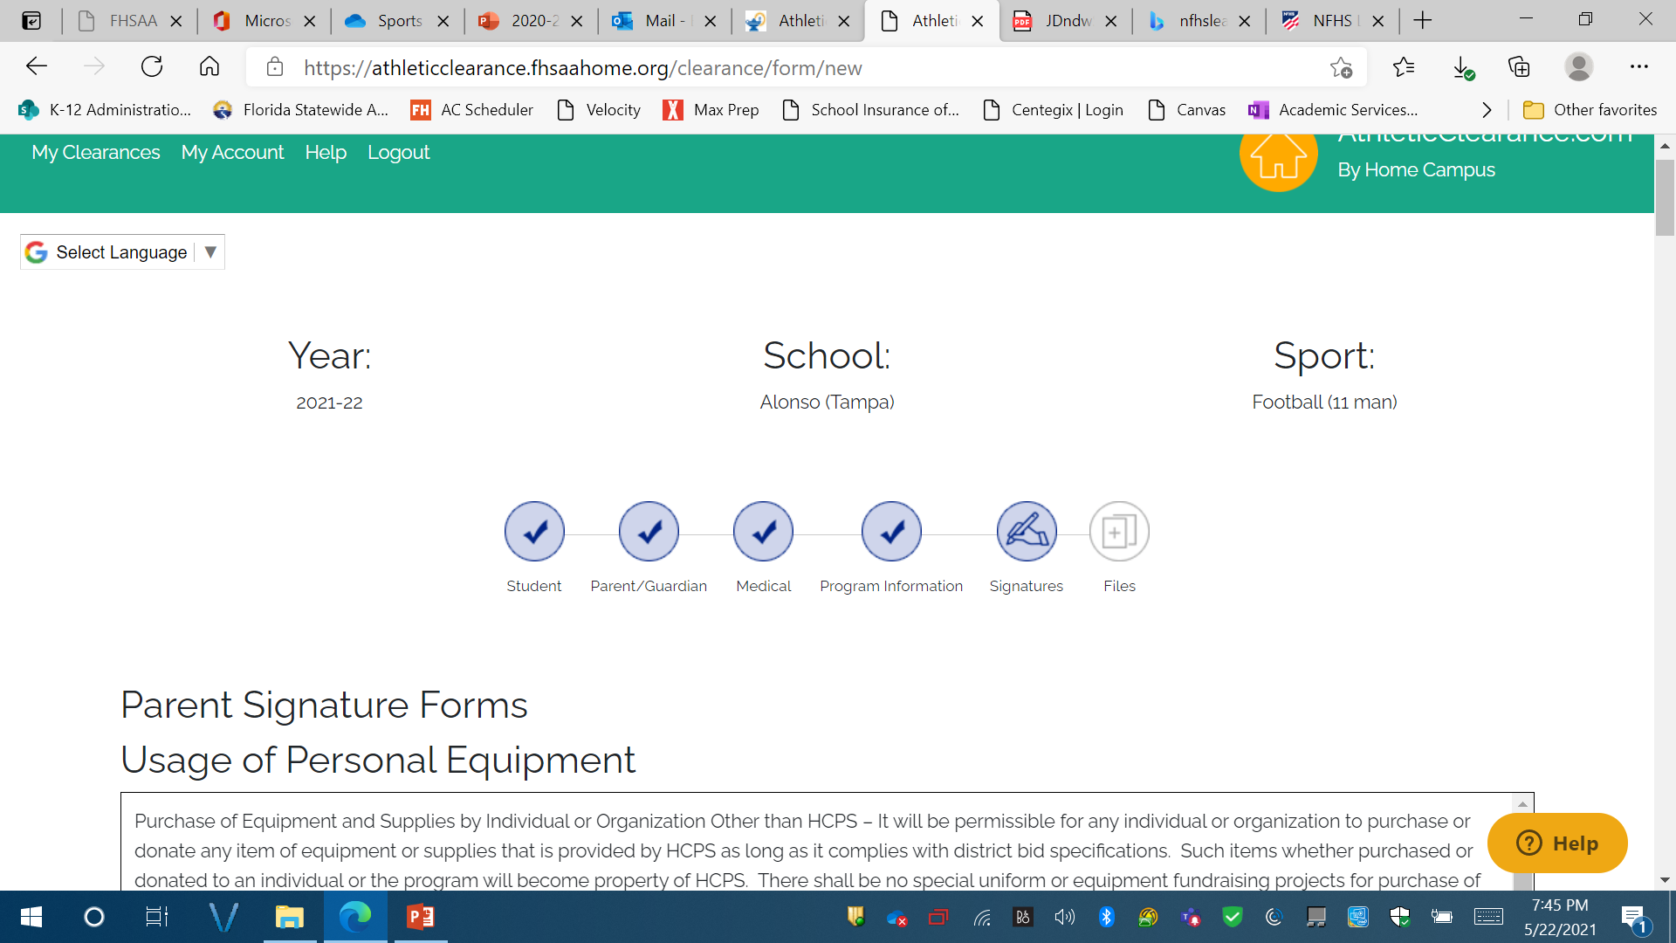
Parent signature forms:
Must sign full name
Note:
IF STUDENT HAS THE SAME NAME AS PARENT SIGNING THE FORMS, DIFFERENTIANTION MUST BE MADE.
FOR EXAMPLE:
John doe, AND John doe JR.
OR
John c doe, AND JOhn S. doe

Slide 24
Important! Read HOW TO UPLOAD FILES:
OPTION 1: USING PDF FILES TO UPLOAD
Click on choose existing files
Upload files in appropriate places.
Scroll down to the bottom of the page and click on Save and Continue.
If you have uploaded all required forms – you will receive a confirmation screen after you click on save and continue and a status of pending.
If you are missing any uploads – you will get an in-processing status. If you get this screen – you are not done, and I cannot see any of your documents.
OPTION 2: USING PICTURES to UPLOAD:
Click on browse
This will give you an option to take a picture
Click on Take a picture
Take a CLEAR PICTURE – DON’T CUT OFF THE EDGES OF THE PAGE. (Don’t worry about the size)
Click on Use picture.
Do this for each document that you need to upload.
Scroll down to the bottom of the page and click on Save and Continue.
You will get a confirmation screen and a status that says pending.
If you are missing any uploads – you will get an in-processing status. If you get this screen, you are not done, and I cannot see any of your documents.

Slide 25
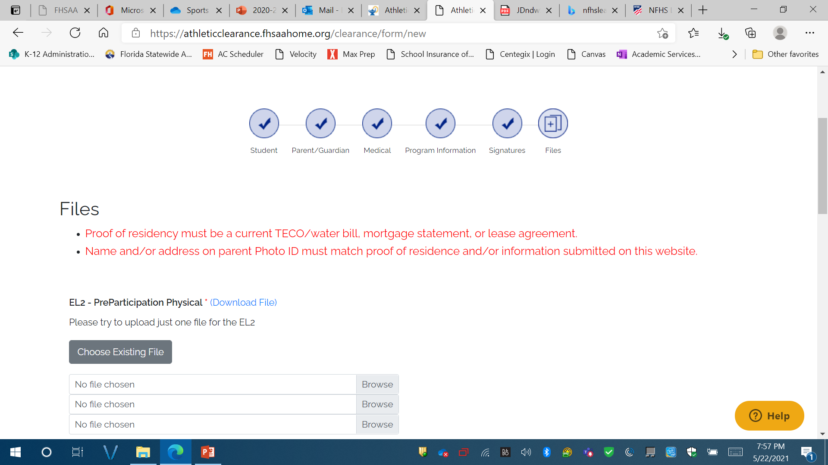
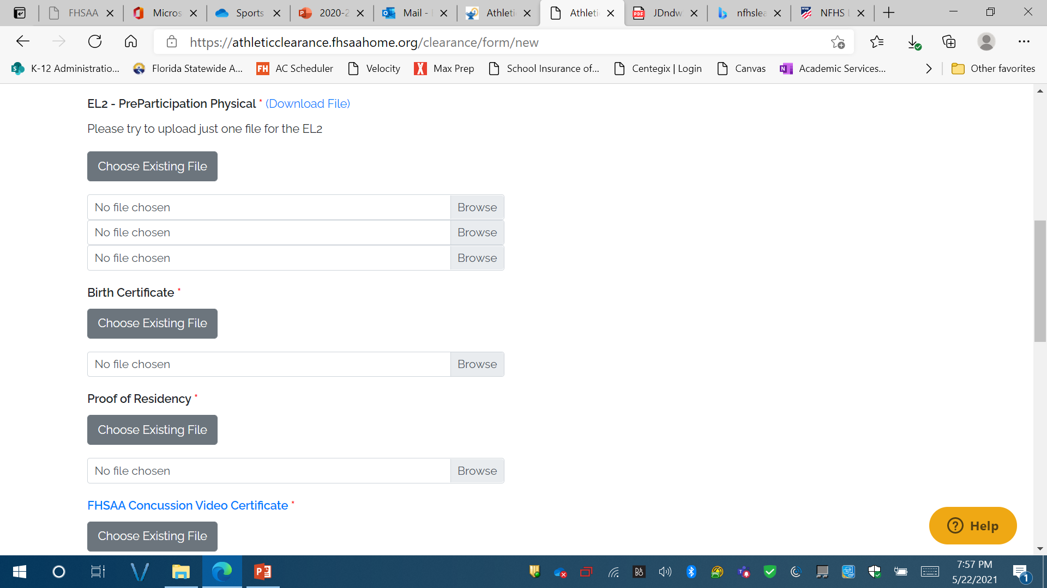
FILE UPLOADS:
  EL2:
    Page 4 – Make sure student and parent sign. Make sure that shot record information is completed. Must be dated.
    Page 4: Must be cleared without limitation
    Doctors printed and signature MUST be on form
    Doctors' office address and phone number MUST be on form
    Page 5: ONLY needed if recommendations were made on page 4.

Slide 26
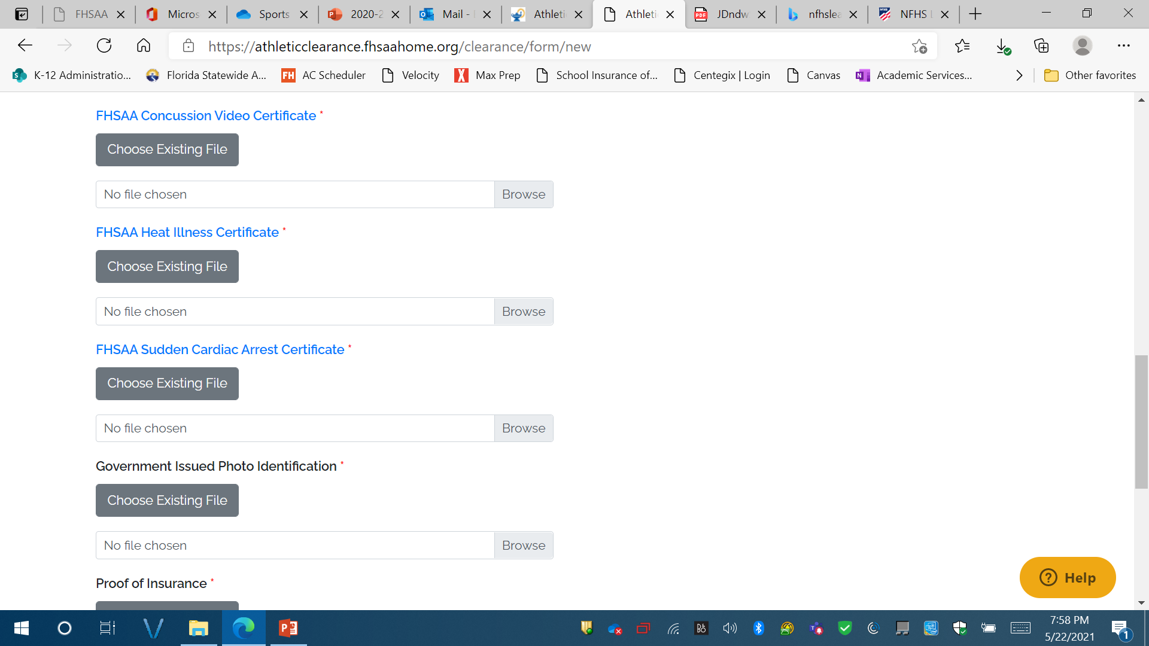
FILE UPLOADS:
  NFHS Video Certificates
    MUST be in STUDENTS NAME
    MUST BE DATED May 15th 2024 or later for 2024-2025 school year
    Concussion – to watch click on link
    Heat Illness – to watch click on link
    Sudden Cardiac Arrest – to watch click on link
FILE UPLOADS:
  Parent signing forms Government Issued ID – with matching address to student address on file at school
  Scroll down and click on save and continue

Slide 27
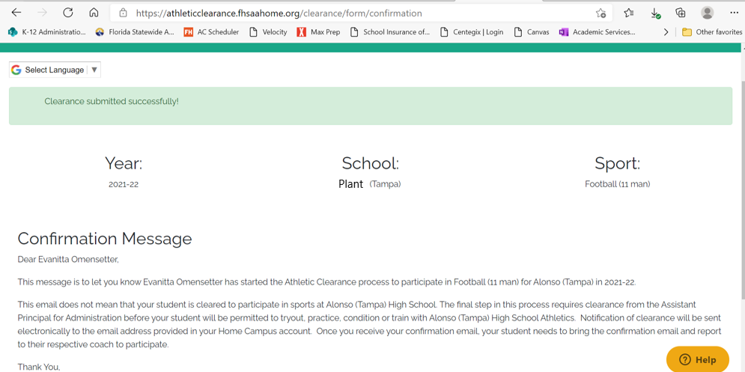
24-25
Lennard

Slide 28
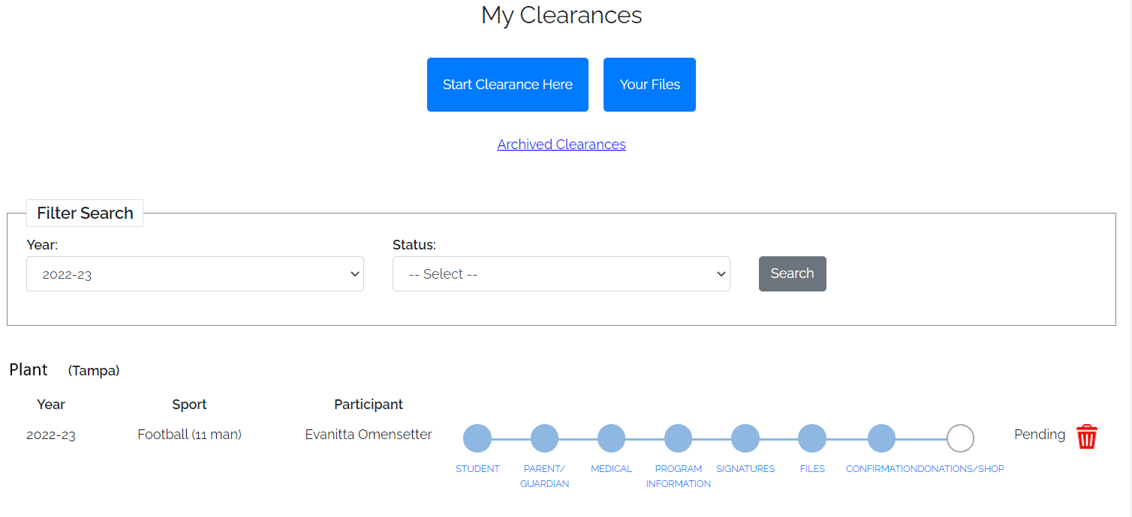

Slide 29

It can take up to 10 days to be cleared. Please be patient and DO NOT wait until the LAST minute.
TECHNICAL ISSUES - should be directed to athletic clearance – click on the help tab and submit a ticket.
If you have any questions –
Please contact our Athletic Department or students should stop by the Athletic Office outside of class time.
GO LONGHORNS!

